Slide 1
Cyber security
Assignment -1

Slide 2
What is cyber security
Cyber security refers to the body of technologies, processes, and practices designed to protect networks, devices, programs, and data from attack, damage, or unauthorized access. Cyber security may also be referred to as information technology security. The technique of protecting internet-connected systems such as computers, servers, mobile devices, electronic systems, networks, and data from malicious attacks is known as cybersecurity. We can divide cybersecurity into two parts one is cyber, and the other is security. Cyber refers to the technology that includes systems, networks, programs, and data. And security is concerned with the protection of systems, networks, applications, and information. In some cases, it is also called electronic information security or information technology security.

Slide 3
Importance of cyber security
Cyber security is important because government, military, corporate, financial, and medical organizations collect, process, and store unprecedented amounts of data on computers and other devices. A significant portion of that data can be sensitive information, whether that be intellectual property, financial data, personal information, or other types of data for which unauthorized access or exposure could have negative consequences. Organizations transmit sensitive data across networks and to other devices in the course of doing business, and cyber security describes the discipline dedicated to protecting that information and the systems used to process or store it. As the volume and sophistication of cyber attacks grow, companies and organizations, especially those that are tasked with safeguarding information relating to national security, health, or financial records, need to take steps to protect their sensitive business and personnel information. As early as March 2013, the nation’s top intelligence officials cautioned that cyber attacks and digital spying are the top threat to national security, eclipsing even terrorism.

Slide 4
Types of cyber security
Every organization’s assets are the combinations of a variety of different systems. These systems have a strong cybersecurity posture that requires coordinated efforts across all of its systems. Therefore, we can categorize cybersecurity in the following sub-domains:
Network Security: It involves implementing the hardware and software to secure a computer network from unauthorized access, intruders, attacks, disruption, and misuse. This security helps an organization to protect its assets against external and internal threats.
Application Security: It involves protecting the software and devices from unwanted threats. This protection can be done by constantly updating the apps to ensure they are secure from attacks. Successful security begins in the design stage, writing source code, validation, threat modeling, etc., before a program or device is deployed.

Slide 5
Importance of cyber security
Today we live in a digital era where all aspects of our lives depend on the network, computer and other electronic devices, and software applications. All critical infrastructure such as the banking system, healthcare, financial institutions, governments, and manufacturing industries use devices connected to the Internet as a core part of their operations. Some of their information, such as intellectual property, financial data, and personal data, can be sensitive for unauthorized access or exposure that could have negative consequences. This information gives intruders and threat actors to infiltrate them for financial gain, extortion, political or social motives, or just vandalism. Cyber-attack is now an international concern that hacks the system, and other security attacks could endanger the global economy. Therefore, it is essential to have an excellent cybersecurity strategy to protect sensitive information from high-profile security breaches. Furthermore, as the volume of cyber-attacks grows, companies and organizations, especially those that deal with information related to national security, health, or financial records, need to use strong cybersecurity measures and processes to protect their sensitive business and personal information.

Slide 6
Benefits of cyber security
The following are the benefits of implementing and maintaining cybersecurity: Cyberattacks and data breach protection for businesses. Data and network security are both protected. Unauthorized user access is avoided. After a breach, there is a faster recovery time. End-user and endpoint device protection. Regulatory adherence. Continuity of operations. Developers, partners, consumers, stakeholders, and workers have more faith in the company’s reputation and trust.

Slide 7
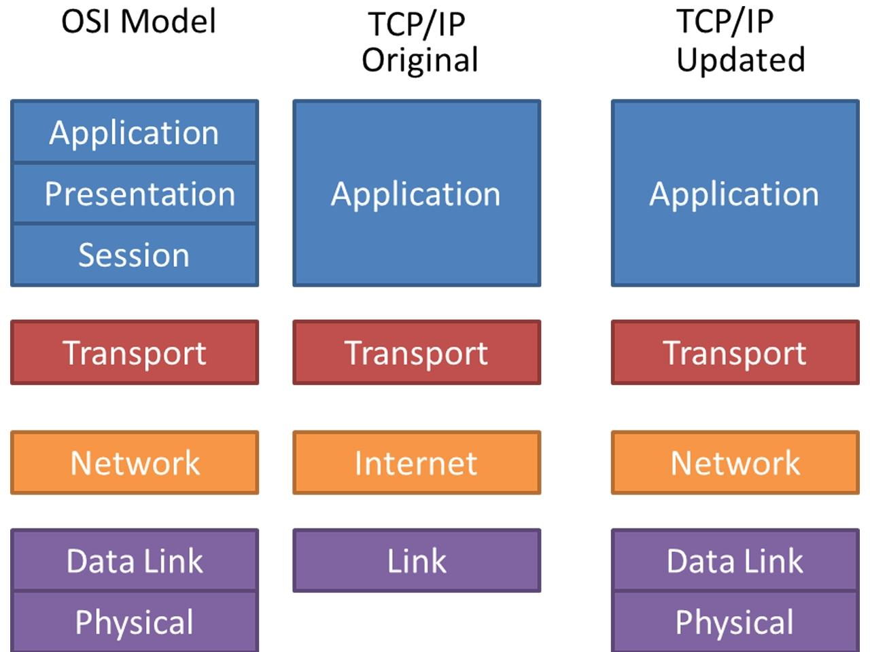
Osi and tcp/ip model

Slide 8
Dashboard of cisco Packet tracer
The CISCO packet tracker was developed by the CISCO Company. It is a type of tool that provides the simulator to practice simple and complex networks. The main purpose of the CISCO pocket tracker is to help the student for the purpose of learning hand on experience in networking. It also provides specific skills for CISCO technology. This tool cannot replace the router or switch because this software has some inbuilt protocol. The interesting thing is that this device has not only the CISCO product but also it has some inbuilt networking support.
This tool also facilitates some technical concepts like CCENT and CCNA, where the packet utilizes all the technical concepts and networking systems.

Slide 9
What is python
Python is a high-level, general-purpose, and interpreted programming language used in various sectors including machine learning, artificial intelligence, data analysis, web development, and many more. Python is known for its ease of use, powerful standard library, and dynamic semantics. It also has a large community of developers who keep on contributing towards its growth. The major focus behind creating it is making it easier for developers to read and understand, also reducing the lines of code.

Slide 10
Features of python
Python has plenty of features that make it the most demanding and more popular. Let’s read about a few of the best features that Python has: Easy to read and understand Interpreted language Object-oriented programming language Free and open-source Versatile and Extensible Multi-platform Hundreds of libraries and frameworks

Slide 11
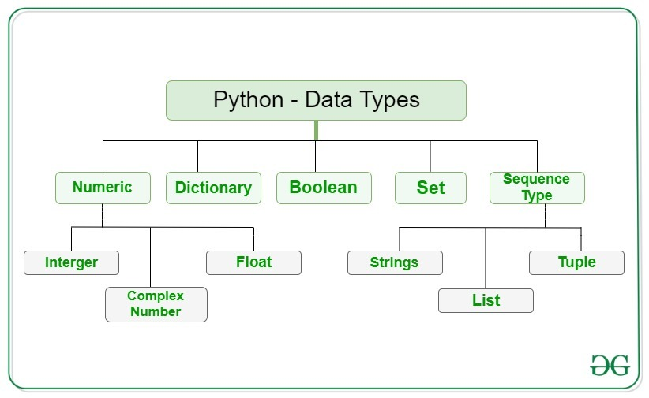
Data types of python

Slide 12
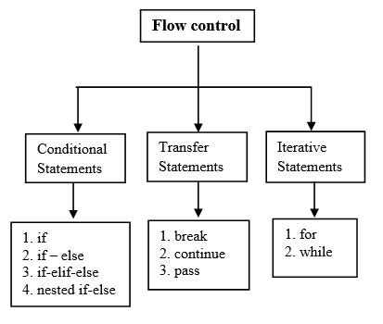
Control structures
Most programs don’t operate by carrying out a straightforward sequence of statements. A code is written to allow making choices and several pathways through the program to be followed depending on shifts in varial.

Slide 13
Introduction to web server
A web server is software and hardware that uses HTTP (Hypertext Transfer Protocol) and other protocols to respond to client requests made over the World Wide Web. The main job of a web server is to display website content through storing, processing and delivering webpages to users. Web pages are a collection of data, including images, text files, hyperlinks, database files etc., all located on some computer (also known as server space) on the Internet. A web server is dedicated software that runs on the server-side. When any user requests their web browser to run any web page, the webserver places all the data materials together into an organized web page and forwards them back to the web browser with the help of the Internet.

Slide 14
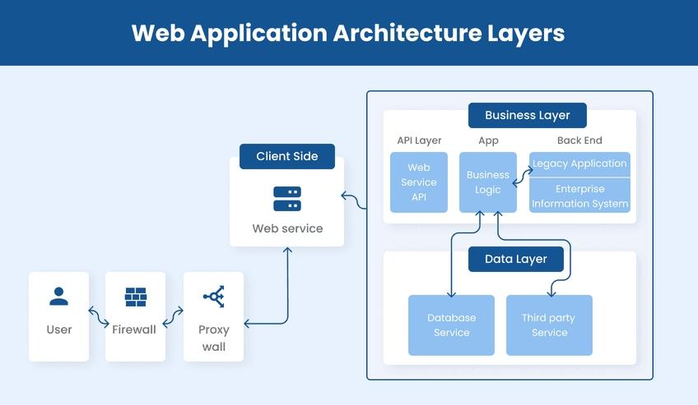
Web application architecture

